Slide 1
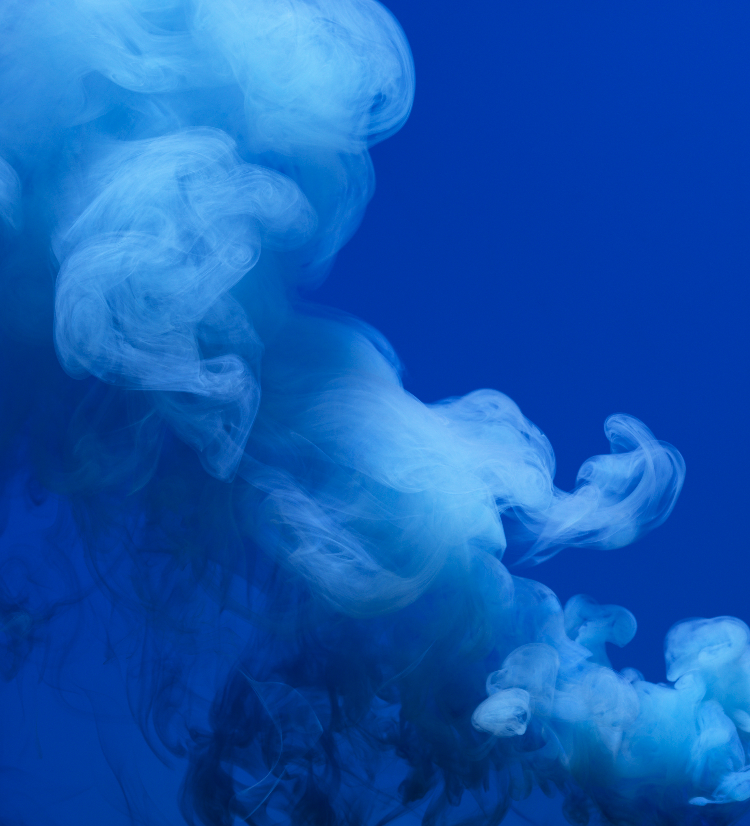
9/16/25
Evaporation
Angelica Ramirez, Hiba Naqvi, Jazmin Aca, Srija Bomma

Slide 2
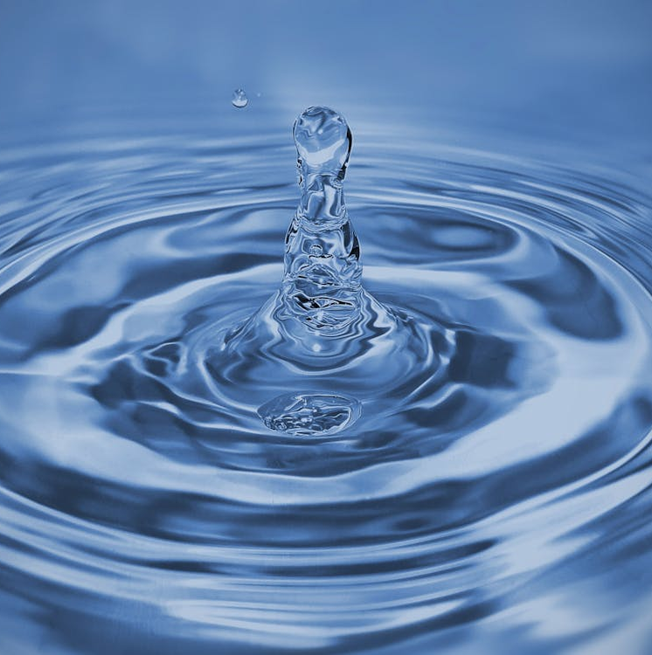
Table of Contents
Introduction
Theory
Apparatus
How to use Equipment
Materials and Supplies
Procedure
What will be Calculated/ Data Needed
Dangers
Challenges

Slide 3
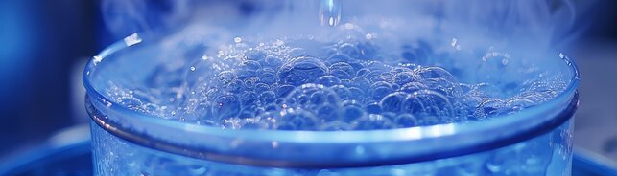
Introduction
Evaporation is a process used to concentrate a solution of a non-volatile solute and a volatile solvent by vaporizing the solvent. The objective of this experiment is to determine the capacity and economy of a single-stage evaporator by evaporating a 10 wt% sugar solution at different pressures.

Slide 4

Theory
Definition: Evaporation is a unit operation involving the concentration of a solution, which involves the removal of a portion of the solvent (typically water).
The basis of Heat transfer is that Steam condensation occurs on a heating surface and transfers energy to boil the liquid.
Vacuum Effect: Decreasing pressure decreases boiling point, and this raises the temperature difference (This raises the heat transfer rate).
Single vs. Multiple Effect:
Single-effect: Steam used once = less than 1 economy.
Multifactor: Reused vapor in follow-up stages = increased efficiency.
Performance Measures:
Capacity = kg water vaporized /time.
Economy = kg of water vaporized/kg of steam utilized.

Slide 5
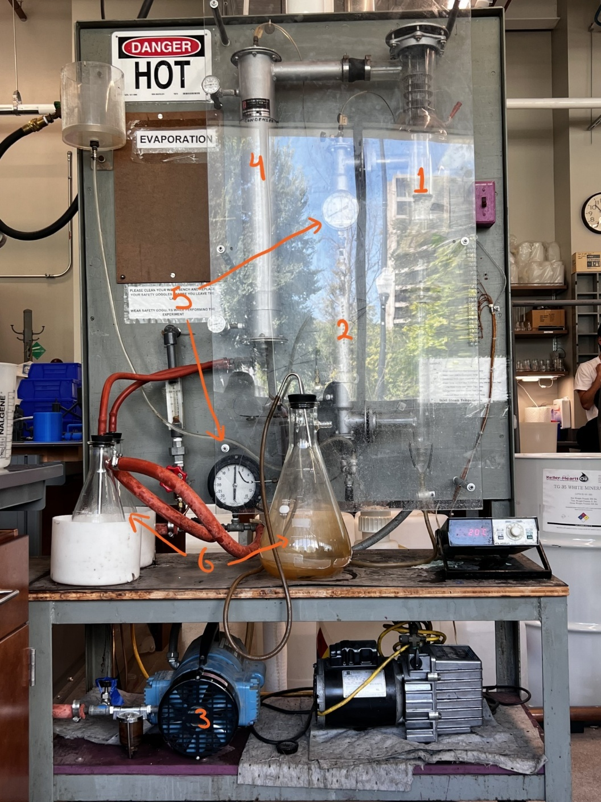
Apparatus
Evaporation Chamber: A Transparent chamber where the liquid is heated.
Heat Exchanger: Provides heat to the liquid to start the process.
Pump: Helps in circulating the liquid through the system.
Condenser: Carries vapor away for condensation.
Gauges: Used to measure conditions inside the system
Storage containers: Used for extra feed or to collect the liquid

Slide 6
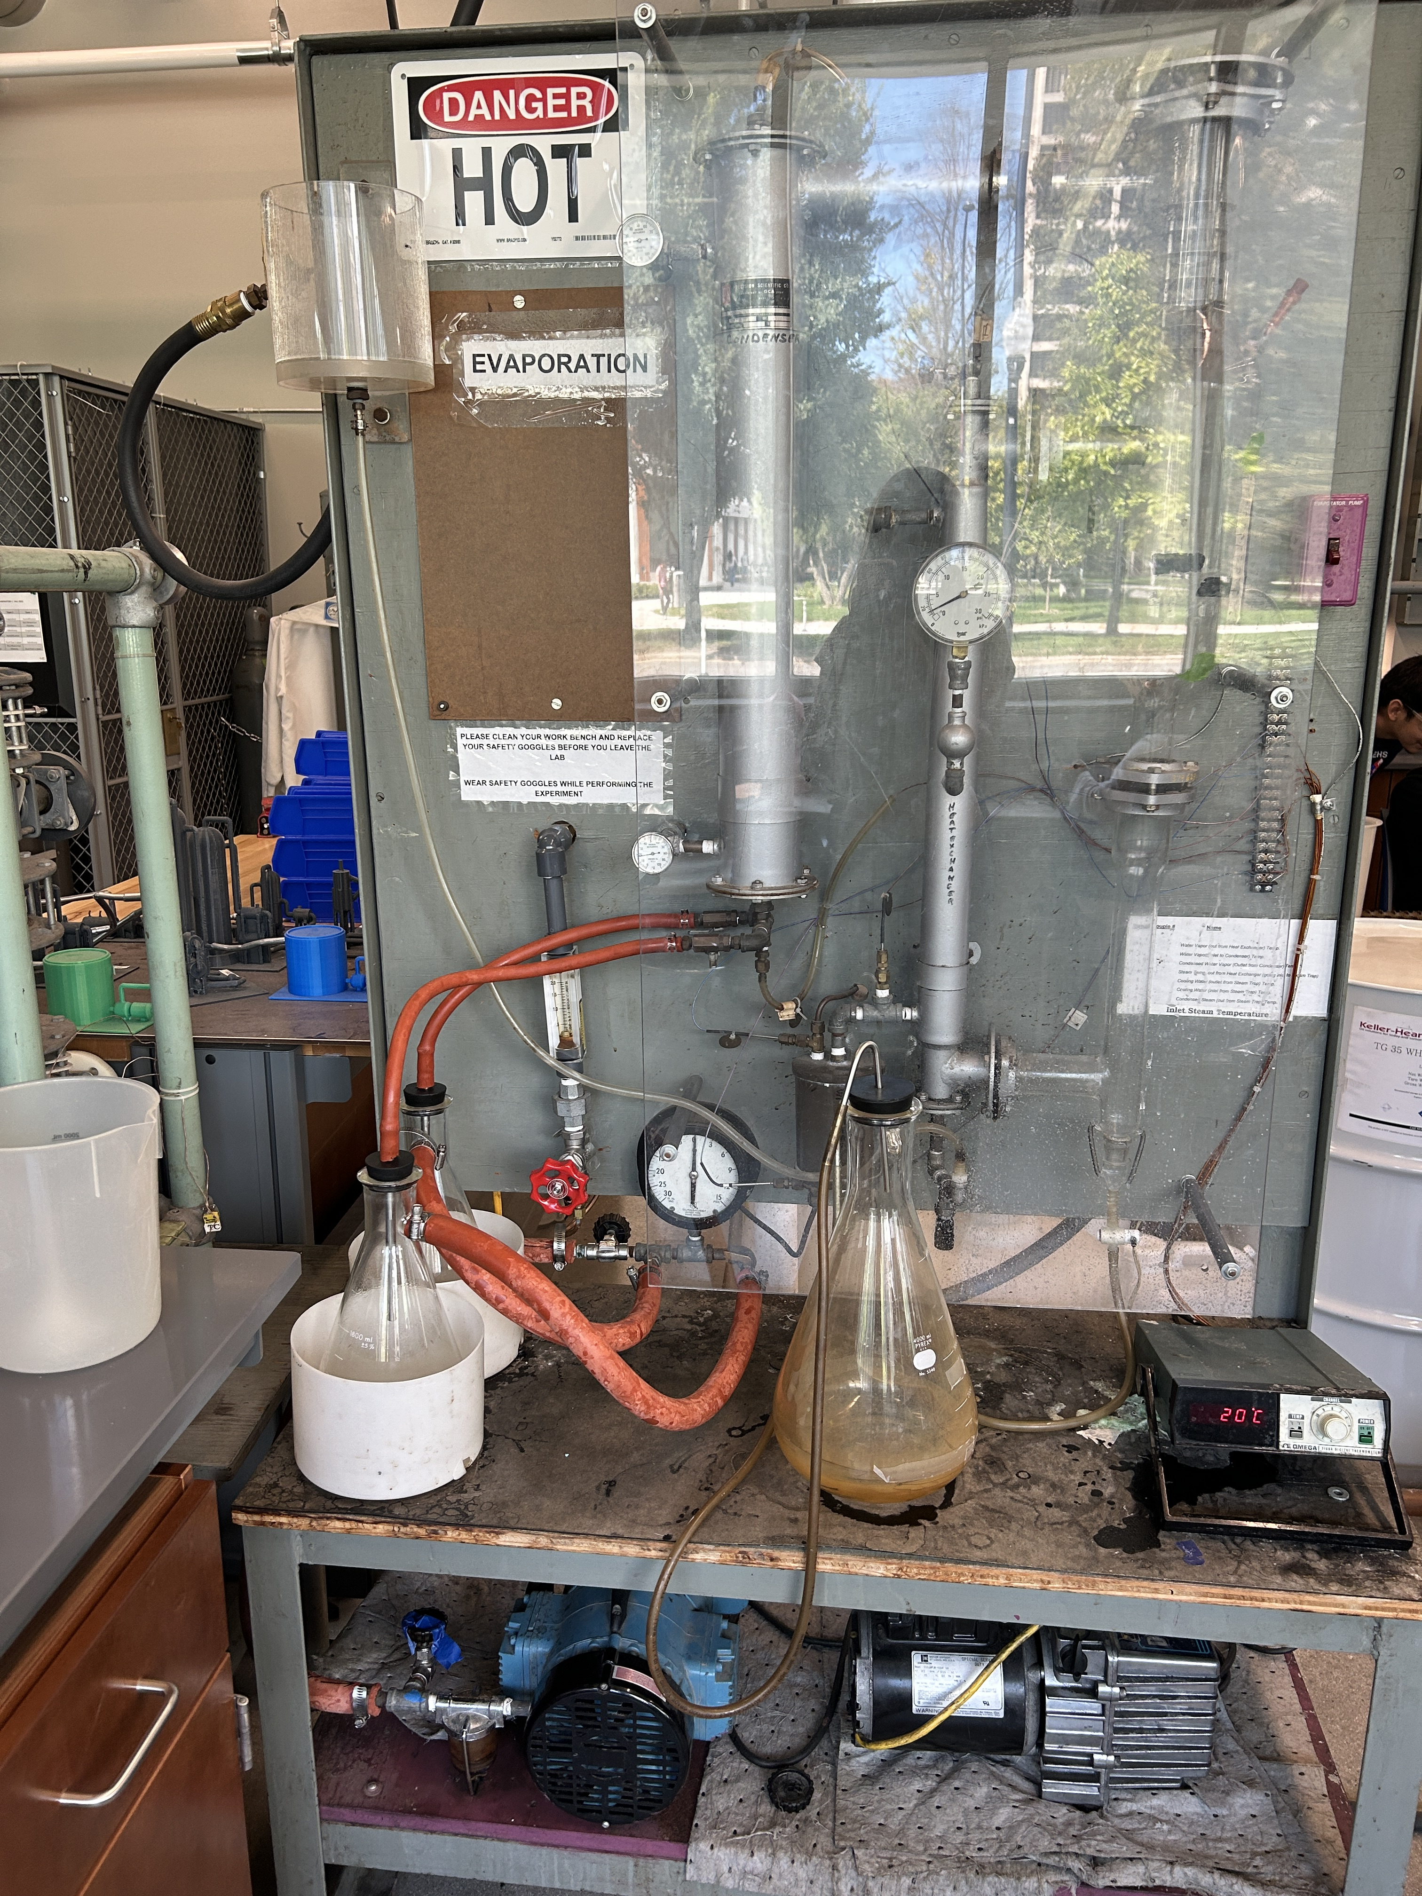








How to use Equipment
Switch to turn on the vacuum.
Knobs to turn on/off the streams into each storage container.
Knob to refill the water in the evaporation chamber.
Knob to turn on the cold-water stream.
Knob to adjust the vacuum pressure.
(behind the board) Knob to turn on the steam.

Slide 7
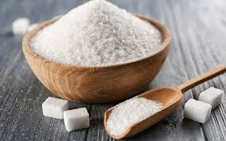
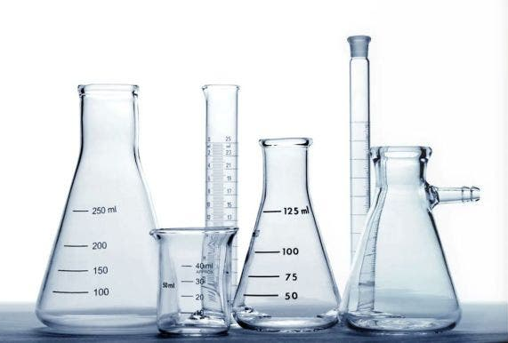
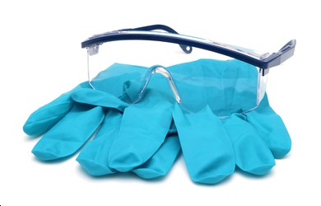
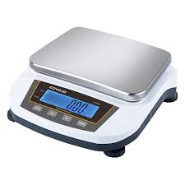
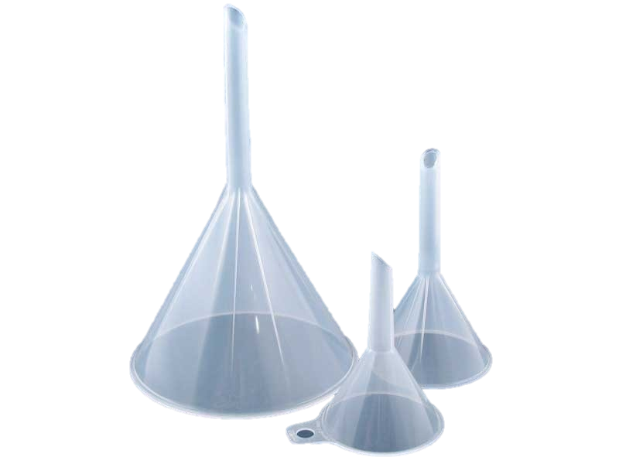
Materials and Supplies
Sugar
Deionized water
Steam
Cooling Water
Scale
Funnels
Gloves
Safety glasses
2000 mL Beaker
Graduated cylinder

Slide 8

Ensure separator is empty
Prepare sugar solution
Fill separator with solution to fill line
Fill makeup tank with DI water
Start flow of steam
Start cooling water to steam trap and condenser
Turn on the vacuum pump
Adjust valve to desired pressure
Wait for the system to reach steady state
Switch outlet valve to an empty Erlenmeyer flask
Begin measuring volume of outlet water with respect to time. Repeat after 5-10 min.
Record flow rate of cooling water, and inlet and outlet temperatures.
Repeat process at a different pressure.
Procedure

Slide 9
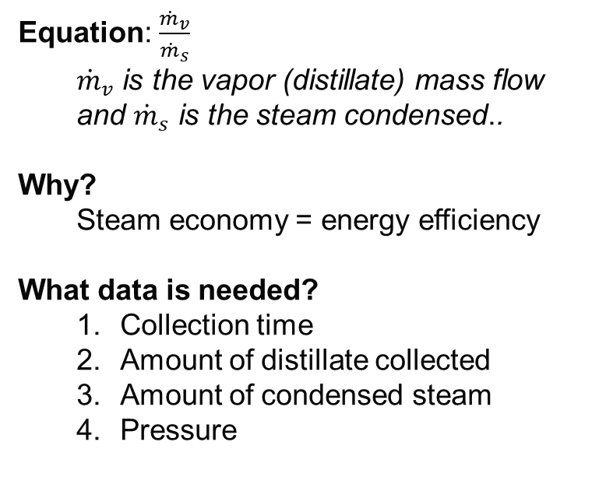
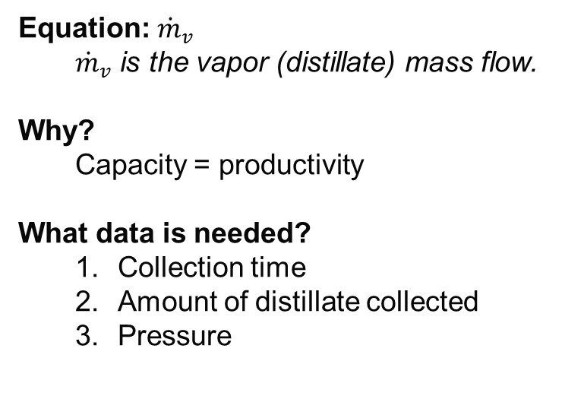
What will be Calculated/Data Needed
Capacity
Steam Economy
Equation: ${\dot{m}}_{v}$
${\dot{m}}_{v}$ is the vapor (distillate) mass flow.
Why?
Capacity = productivity
What data is needed?
Collection time
Amount of distillate collected
Pressure
Equation:$\frac{{\dot{m}}_{v}}{{\dot{m}}_{s}}$
${\dot{m}}_{v}$ is the vapor (distillate) mass flow and ${\dot{m}}_{s}$ is the steam condensed..
Why?
Steam economy = energy efficiency
What data is needed?
Collection time
Amount of distillate collected
Amount of condensed steam
Pressure

Slide 10
Dangers
Wires can potentially be exposed to water
Vessels could implode due to pressure
Steam and water will be at a high temperature

Slide 11
Challenges
Always keep the water level constant. Make sure to have a person watching it
Have distilled water at the bench
Be quick with draining so the vacuum doesn’t stay closed for long periods of time
Have someone holding the pressure adjusting knob to keep pressure constant
Open both streams at the same time during the collecting period to ensure you have accurate readings
Do a trial run before starting the actual experiment

